Slide 1
MCSD Certification Toolkit
Chapter 3, Lesson 3

Slide 2
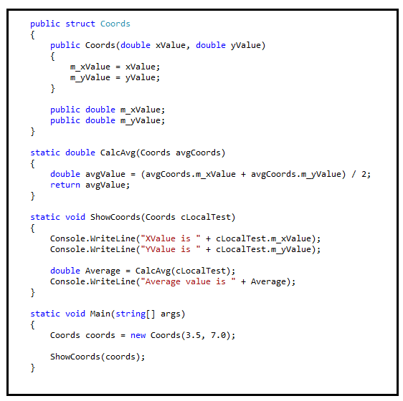
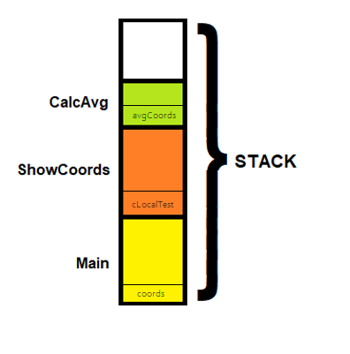
Methods – Passing by value

Slide 3
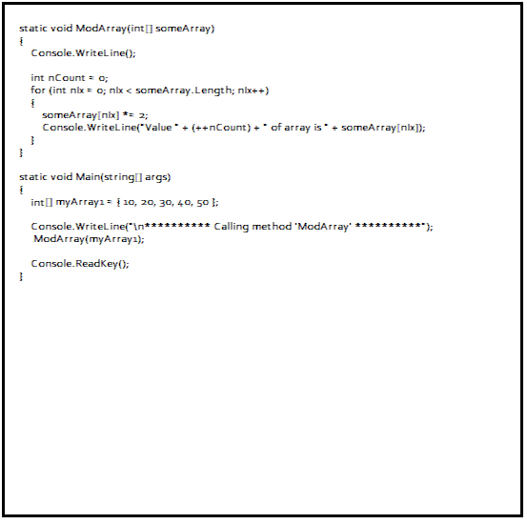
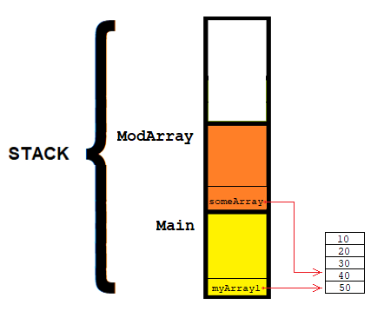
Methods – Passing by reference

Slide 4
Ref vs Out
Ref | Out
The parameter or argument must be initialized before it is passed as a ref parameter. | It is not compulsory to initialize a parameter or argument before it is passed as an out parameter.
It is not required to assign or initialize the value of a parameter (which is passed by ref) before returning to the calling method. | The called method is required to assign or initialize a value of a parameter (which is passed to an out parameter) before returning to the calling method.
It is not compulsory to initialize a ‘ref’ parameter value before using it in a calling method. | An ‘out’ parameter value must be initialized within the called method before its use.

Slide 5
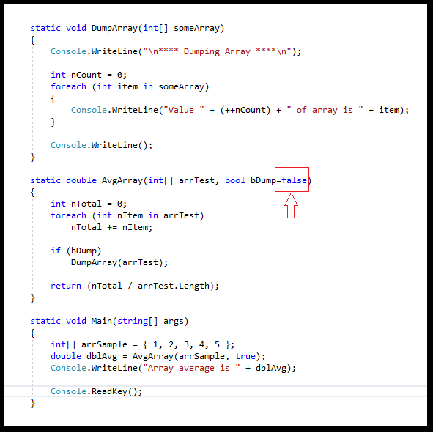
Methods – Optional parameters
When caller does not supply parameter, compiler fills in default.
Multiple default parameters allowed.
Default parameters must be last in method definition.

Slide 6
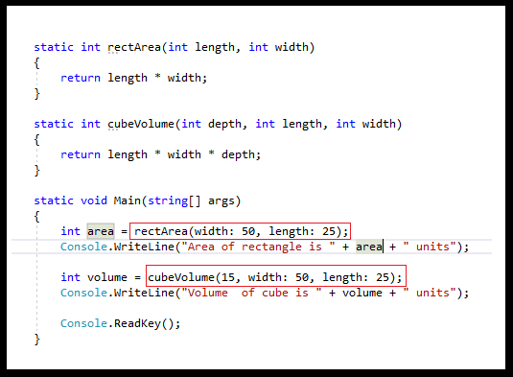
Methods – Named parameters
Order of named parameters is irrelevant
Makes code easier to read
When mixed with positional parameters, positional parameters must come first

Slide 7
Class Declaration and Usage
Declaration
public enum GENDER
{
MALE,
FEMALE
}
public class Person
{
public Person(string FName, string LName, GENDER gender)
{
m_FName = FName;
m_Lname = Lname;
m_Gender = gender;
}
public string m_FName;
public string m_LName;
public GENDER m_Gender;
};
Usage
Person KimC = new Person(“Kim”, “Chiu”, GENDER.FEMALE);

Slide 8
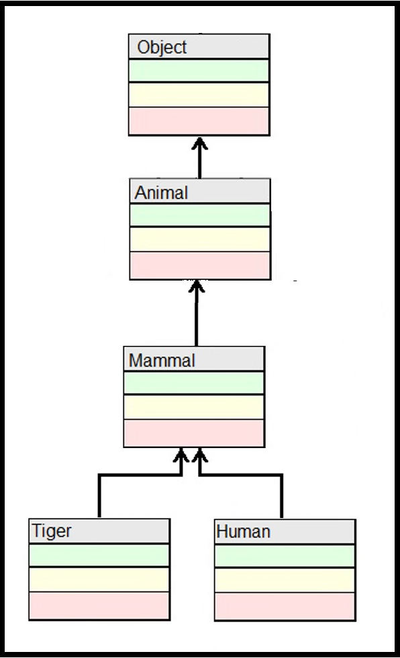
Inheritance in C#
All classes have class ‘Object’ as their root
The visibility of each class member is declared separately.
Each class can have no more than 1 base class
File ‘Animal.cs’
public class Animal
{
public Animal()
{
m_sName = “Unknown”;
}
public Animal(string sName)
{
m_sName = sName;
}
protected string m_sName;
}
public class Mammal : Animal
{
public Mammal()
{
m_sName = "Unknown Mammal";
}
public Mammal(string sName)
: base(sName)
{
}
}
class Tiger : Mammal
{
}
class Human : Mammal
{
}

